Slide 1
UHabit App - Second Progress Report
Group 7: Shanyu, Joe, Trung, Zachary

Slide 2
UHabit Mobile App - Recap
Stack:
Frontend: Flutter and Dart
Database: Postgresql
Backend: Springboot
What is “UHabit”?
It is a mobile application where users can track their habits daily. Users create and share habits with their friends, and are able to see their friends’ habit progress as well! Users are able to check off habits once a day per habit to indicate they have completed that habit for the day.
What we focused on for this sprint cycle:
We are mainly focusing on creating a friend’s page UI where you are able to see friends’ habit progress and accept/reject/send friend requests.
What we focused on the last sprint cycle:
We focused on account creation and ticking off habits, creating simple UI and allowing users to sign in via Google.

Slide 3
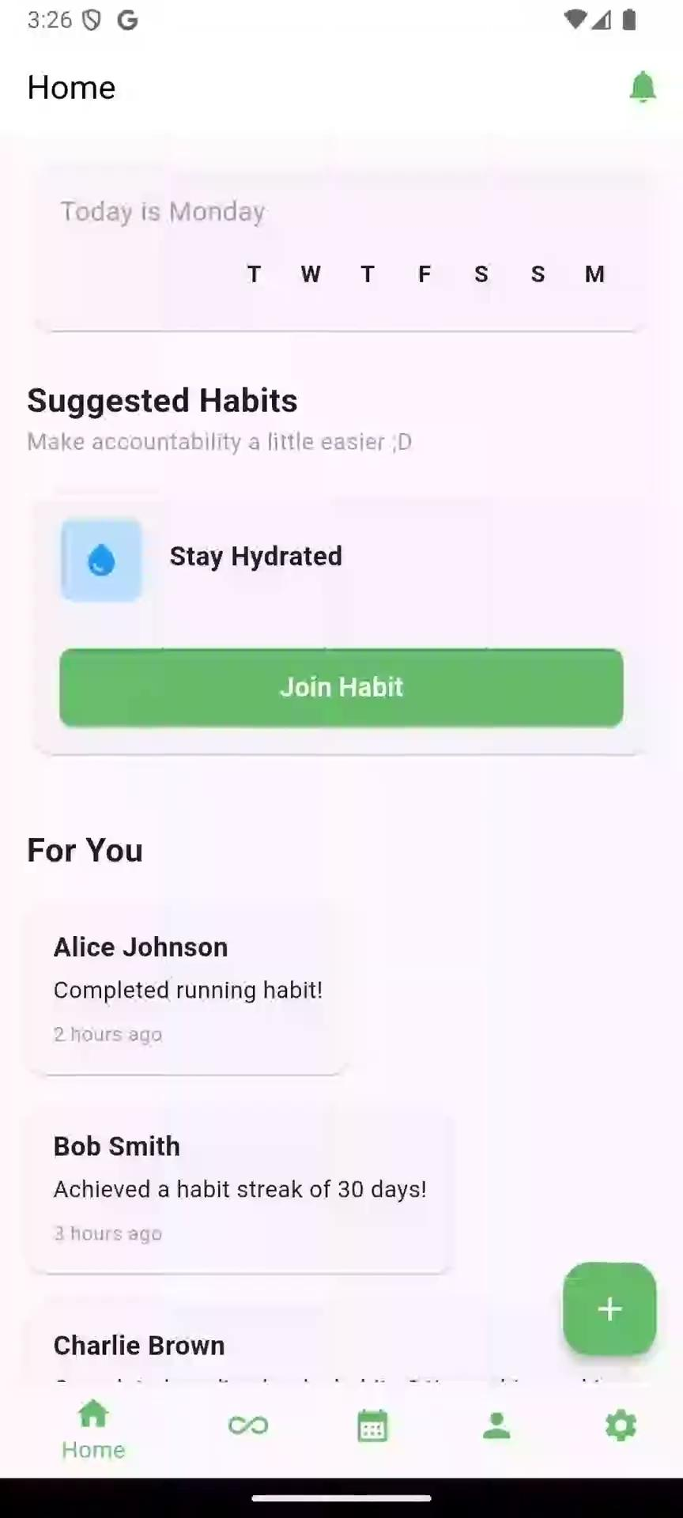
Our Progress - Video
Things included in this video:
Accepting Friend Requests
Looking at Friends’ habits on profile
Rejecting Friend Requests
Sending Friend Requests

Slide 4
Explanation of Video
User accepts Friend Request from “Gordon Ramsay”. User then clicks on Gordon to see their profile which displays their calendar of completed tasks as well as their associated habits at the bottom (which you can choose to subscribe to from there if interested!)
User rejects Friend Request from “Ronaldo Nazario”.
User sends a Friend Request to Taylor Swift and a few other people.

Slide 5
How we Implemented “The Laws of User Interface Design”
Law of Clarity (Consistency):
Consistent colors (green, white, and black text).
Consistent navigation bar with easy to understand icons.
Law of Preferred Action:
All actions/navigation pages are labelled to help user understand where they are and what they can do
Law of Context:
Allows users to accept/reject friend requests with icons close to the user.
Law of Defaults:
All user profile icons are set to a blank silhouette.
Law of Feedback:
The users are notified that the friend request has been accepted/rejected.
Law of Easing:
On the friend’s page, the user’s “friends”, “friend requests”, and “people you may know” are all separated in a separate area/dropdown menu.

Slide 6
Next Steps
Work on improving the user interface
Make ticking off more user-friendly and “gamify” it
Make friends’ habits be shown weekly (like on main page) and have a separate tracker for each habit
Work on being able to set habits to private
Improve the calendar page so that every habit has its own little calendar

